Slide 1
Project Details
Gavin Werenczuk, Gwen Tran, Chris Greenup

Slide 2
Features
Tuner
Uses a microphone to listen for a note and tells what the note’s pitch is and how in-tune it is
Metronome
Will play a click at a steady rate that the user defines
History
Keeps track of what notes were played and how in tune each was
Audio Analysis
Displays the result of the Fast Fourier Transform (FFT) as a graph

Slide 3
Tuning
Give a visual indication for tuning
Displays what note it hears
Displays how in-tune that note is
Optional displays for stringed instruments
Have layouts to emulate the layout of a guitar, ukulele, and bass guitar
Menu for predefined tunings
Option to change tuning note per string
Will give the option for the user to use a custom tuning pitch
Option will be Baroque tuning, A = 440 hz, or A = 432 hz
Notes:
Gaving

Slide 4
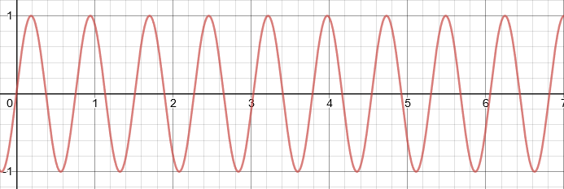
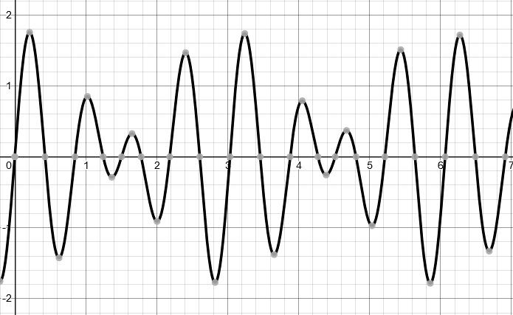
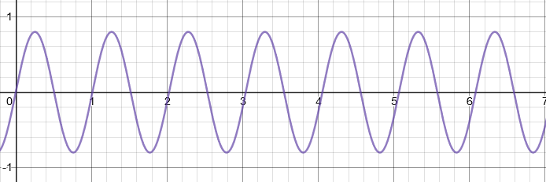
Waves
+
Notes:
A quick math aside: To understand how tuners work it is best to understand some simple wave manipulation stuff. For starters, when you have two waves, you can add them together to create a new wave function. This wave function is made by adding wave functions. When this is done, it’s not easily undone: it’s hard to know what frequencies make up a wave function from just the wave function alone. That’s where fourier transforms come into play

Slide 5
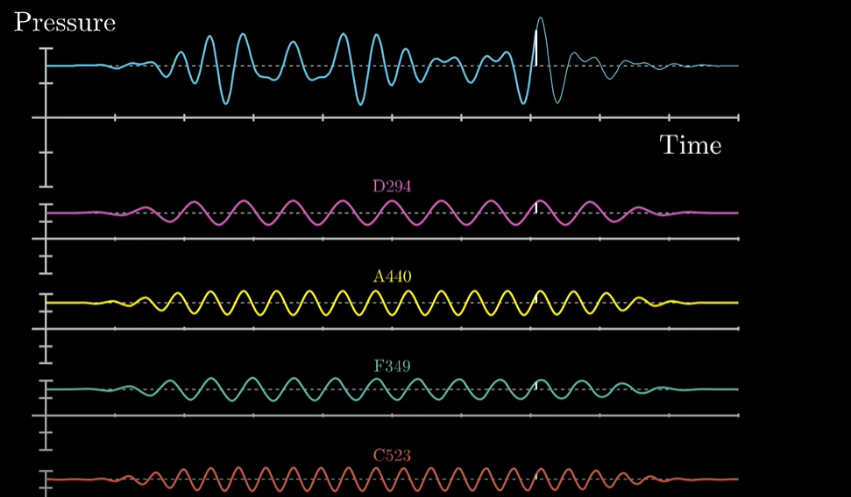
Example of Frequency Combination

Slide 6
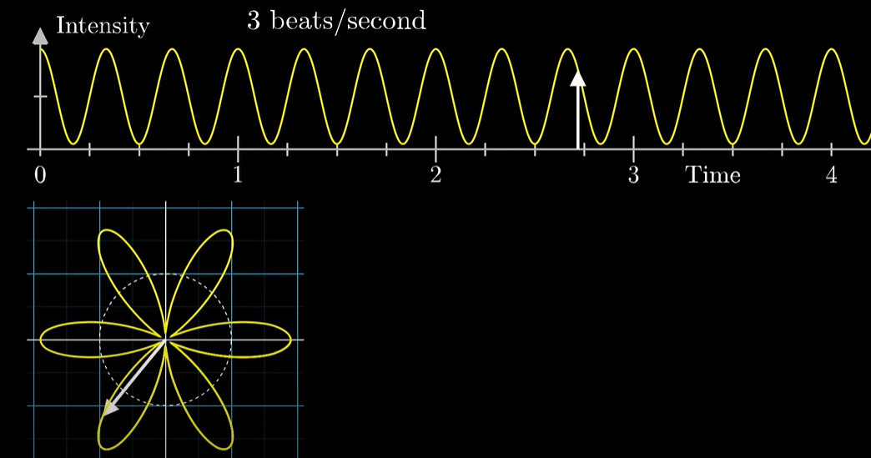
Wrap Frquency Graph around a circle

Slide 7
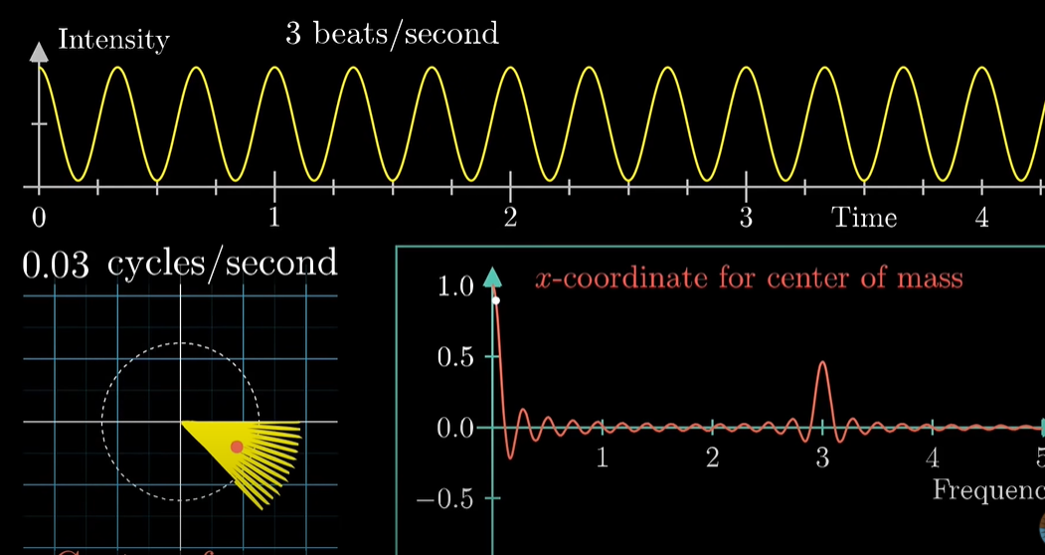
Transform the center of mass circle into a center of mass graph

Slide 8
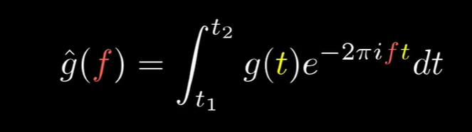
Fourier Transform Function
g(t): function in term of time vs intensity
g^(t): function in term of frequency
g^(t) =
e^(-2πit) is a function that describe circle

Slide 9
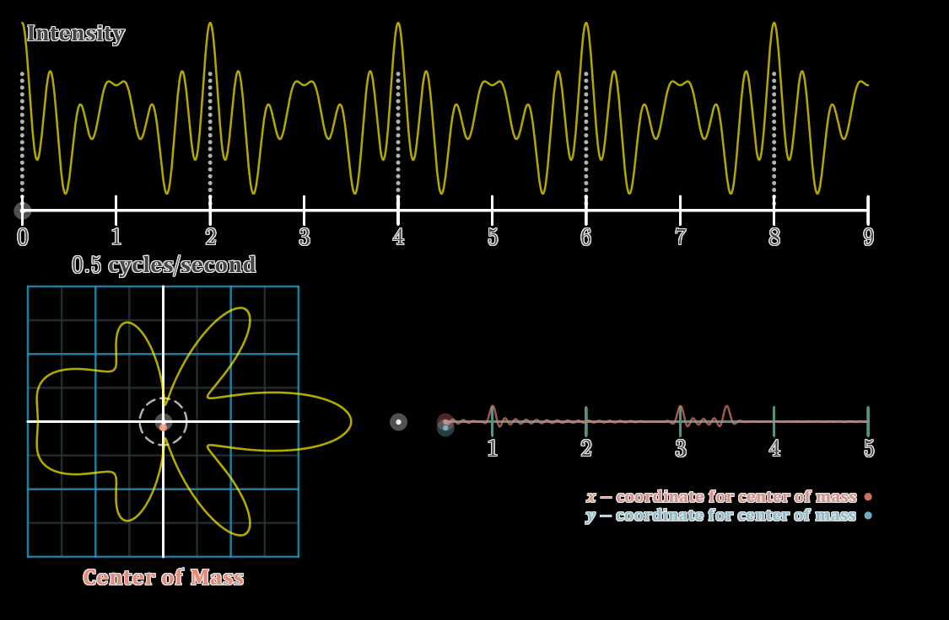
Fourier Transforms
Notes:
Fourier transforms turn a complex wave function into an encoded wave function. It doesn’t immediately separate the frequencies out, but it does tell you what frequencies make up the complex function, as well as how loud each frequency is

Slide 10
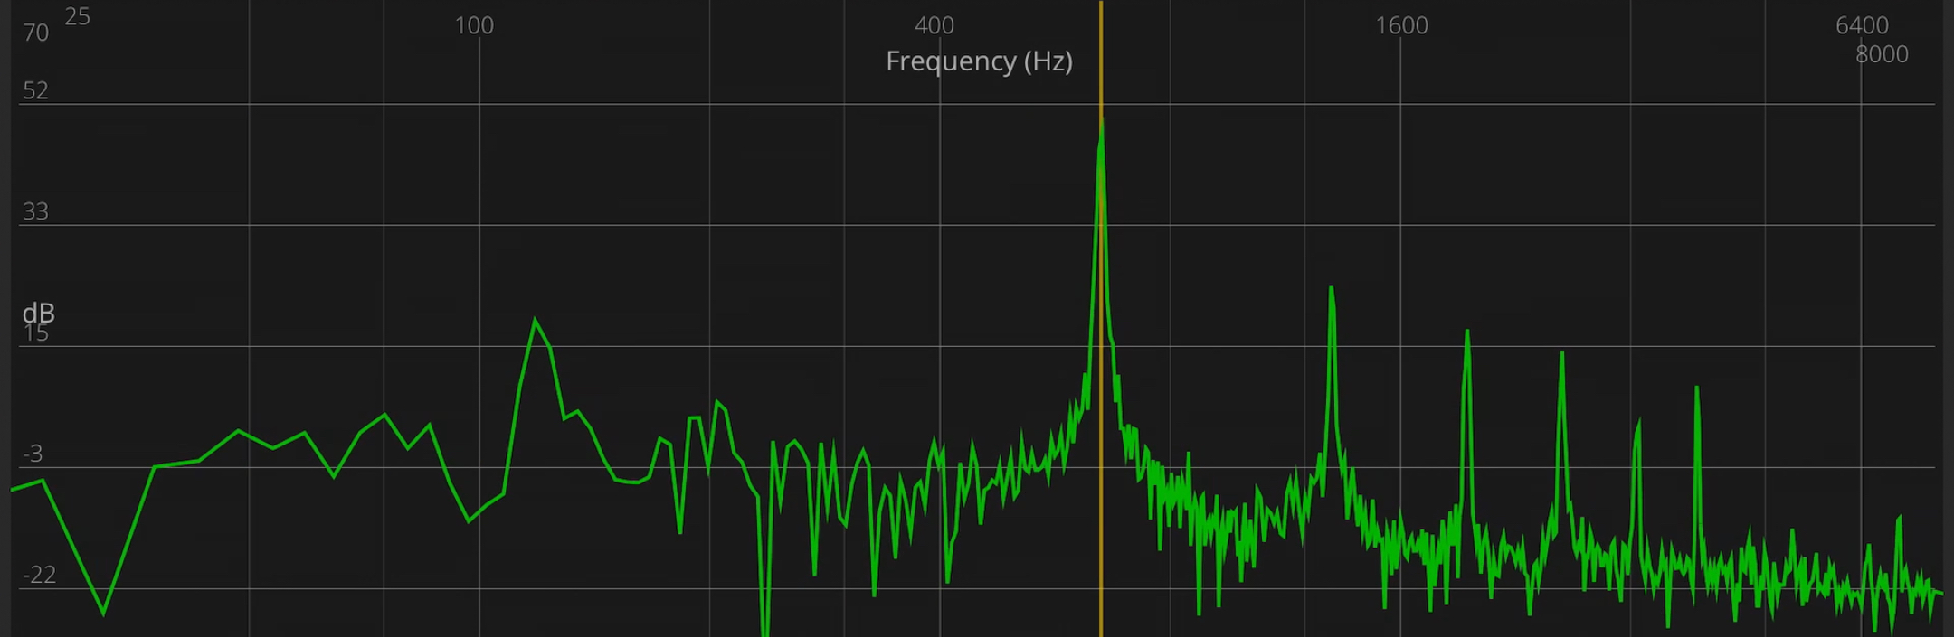
Analyzing Fourier Transforms
Notes:
Now that we have an output for the transform, how do we go about analyzing the data? First, we need to filter out most of the background audio that it hears. By simply waiting until there is a signal louder than a certain threshold we can filter out a good enough amount of noise

Slide 11
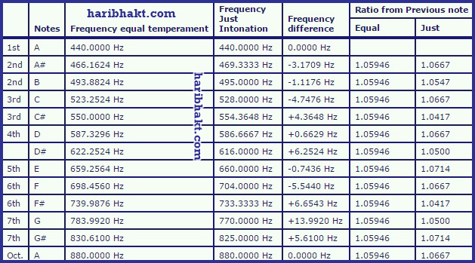
Frequency Tables

Slide 12
Note Player
Used for tuning by ear
Displays a list of buttons of all notes in an octave
Optional displays:
Piano keyboard-like layout
A simple left to right display of all the notes
Option to keep playing the note without having to hold down click
Plays a sine wave at the same frequency as the note listed
Notes:
Gavin

Slide 13
History
Displays all the notes played during any particular day
Shows what the note names are
Shows the average tuning of each note

Slide 14
Metronome
BPM selection
Type in BPM
Or Plus or Minus
Time Signature Selection
User can type in how many beats are in a measure
User will select using a drop-down what subdivision gets the beat
Display visual
Segmented into how many beats in a measure

Slide 15
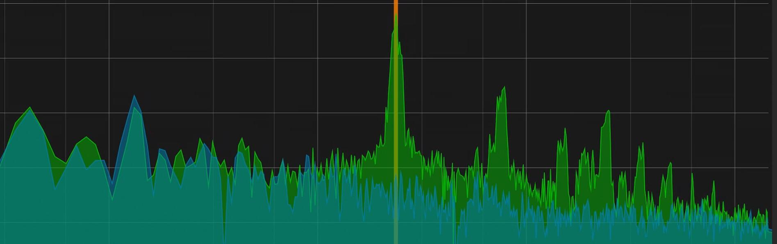
Audio analysis
Displays the output of the FFT
Option to freeze a certain frame of the FFT
This can be used for comparing a past audio sample to a current one
Display when the app recognizes a note and where it’s finding it.

Slide 16
Tricky Requirements
History Function
How will we be recording this information
How long should it be before we record notes as two notes
Note Player
If we include different note systems, how should the layout look
Should we include polyphony or not

Slide 17
Concerns
Microphones don’t have the same sensitivity
Not knowing terms
Ambient Noise is never the same

